Slide 1


An Analysis of More Than 13,000 Patient-Specific IMRT QA Results
K. Pulliam, MS^{1,2}., D Followill, PhD²., L Court, PhD²., L Dong, PhD³., M Gillin, PhD²., K Prado, PhD³., S Kry, PhD²
¹The University of Texas Graduate School of Biomedical Sciences at Houston, Houston, TX; ²Department of Radiation Physics, The University of Texas MD Anderson Cancer Center, Houston, TX; ³Department of Radiation Oncology, University of Maryland School of Medicine, Baltimore, MD

Slide 2
Introduction
IMRT QA is a standard for routine verification of treatment plans
  Numerous devices and criteria used
Absence of standard QA device or criteria
  No clinical reference for QA pass/fail rates

Slide 3
Purpose
To review our institution’s patient-specific IMRT quality assurance (QA) results, including absolute dose and gamma analysis measurements for 13,002 treatment plans from 2005 to 2011.

Slide 4
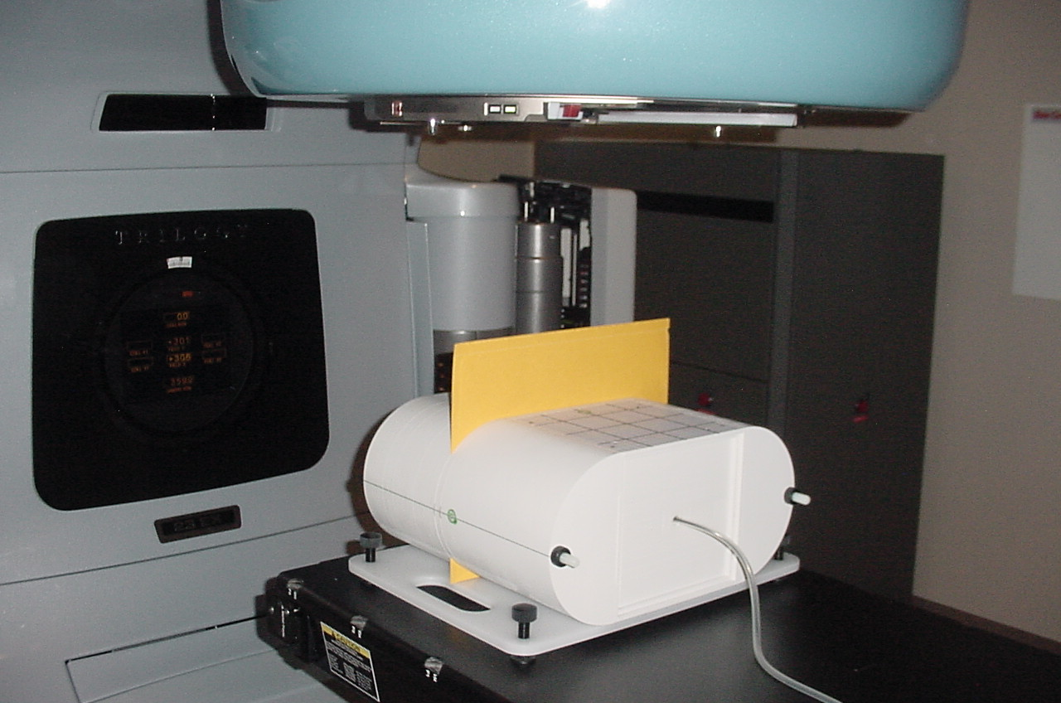
Methods: QA at MD Anderson
Absolute point dose made in homogenous phantom with CC04 ion chamber
  +3% agreement criteria
Relative planar dose gamma analysis
  90% of pixels passing a 5%/3mm criteria

Slide 5
Methods: Results Analysis
13,002 treatment plans from 2005 to 2011
  13,308 point dose measurements
  12,677 gamma measurements
Plans across 13 different treatment services
  Breast, CNS, GU, GI, GYN, hematology, H&N, stereotactic spine, melanoma, mesothelioma, pediatric, sarcoma, and thoracic

Slide 6
Results: Overview
Treatment service | # of plans | Mean dose difference (%) | One SD (%) | # of absolute dose failing plans/ (% of service) | Mean gamma (%) | # of gamma failures/(% of service)
GU | 1831 | -0.17 | 1.2 | 11 (0.6) | 97.6 | 2 (0.1)
THOR | 2951 | -0.53 | 1.4 | 46 (1.6) | 97.8 | 23 (0.8)
HN | 3697 | -0.45 | 1.6 | 76 (2.1) | 97.7 | 33 (0.9)
GYN | 935 | 0.29 | 1.6 | 24 (2.6) | 97.6 | 8 (0.9)
PEDI | 307 | -0.25 | 2.0 | 18 (5.9) | 97.8 | 2 (0.7)
IMSSRT | 341 | -1.59 | 2.8 | 54 (15.8) | 97.6 | 4 (1.2)
MESO | 52 | 2.60 | 2.6 | 11 (21.2) | 94.4 | 6 (11.5)
Total | 13002 | -0.29 | 1.6 | 302 (2.3) | 97.7 | 95 (0.7)
*Not all data displayed
Notes:
Only representative sites are shown. Sites that were statistically homogenous with other sites were not displayed. Summary of data. All of the sites had, on average, mean dose values within tolerance. Of note are the two sites that were closest to tolerance: Meso and IMSRT. As you can see, Meso has the highest MD and a large SD and a correspondingly high rate of QA failures (21% of plans). Meso plans consist of large treatment fields with many beams (20 plus) resulting in very complex plans for which the effects of scattered radiation is not modeled well in the TPS. If we look at the IMSSRT group, we have similar problems related to small fields.

Slide 7
Results: Absolute Dose Trends
V. 6
V. 7
V. 8
V. 9
Notes:
Data was split into two groups: the group that included all measurements and sites and a subgroup that only had the 3 busiest services (GU, HN, THOR) to evaluate trends without the biasing effects of the MESO and IMSSRT services. We found that over time, our dosimetric agreement has improved. This improvement roughly corresponds to our transitions to newer versions of Pinnacle.

Slide 8
Results: Absolute Dose Failure Rates
Notes:
Despite the improved dosimteric agreement over the years, our failure rates have remained fairly steady with similar trends for both the overall and subgroup.

Slide 9
Results: Gamma Trends
Notes:
The trends for gamma results are the same for both groups and show less than a 2% change from 2005 to 2011.

Slide 10
Results: Gamma Failure Rates
Film Processor Problems
Notes:
The failure rate dropped dramatically after 2005, remaining at less than 0.4% for the rest of the time. Of note, all or most of the failures in 2005 and 2006 were attributable to film processor error. Gamma failures do not result in repeated measurements or changes to clinical plans.

Slide 11
Results: Absolute Dose Failure Follow-Up
Number of plans with absolute dose failure | 302
Single absolute dose failure (> ±3%)
Passed with remeasurement | 188
Failed with remeasurement | 52
Multiple absolute dose failures (> ±3%)
Passed with remeasurement | 34
Failed with remeasurement | 28
Notes:
Of the 302 plans that failed QA at one or more points, this table illustrates the QA follow-up that was performed. Of the 302 failing plans, 188 failed once and passed with a single subsequent re-measurement at a different calculation point. Of those, 16 passed using a special beam delivery, specifically the splitting of multiple carriage plans into separate plans (MC split) and delivery of all beams from 0 degree gantry angle (AP).

Slide 12
Considerations
Do we need the same level of QA for sites that overwhelmingly fall within tolerance (GU, GYN, etc)?
Do we need additional QA needed for sites that routinely fall outside tolerance (MESO, IMSSRT, Pedi)?
  Or use site-specific criteria that allows for constant failure rate
Is gamma analysis useful for catching plans errors?
Notes:
GU, GYN had failures less than 1%. Meso IMSSRT PEDI have rates of 6% or more

Slide 13
Conclusions
Point dose agreement has improved with time (~1.35% to 1.1%)
  Constant failure rates (~2.3%)
Substantially different rates of failure by treatment service
  21.2% for Mesothelioma vs 0.6% for GU
Gamma not sensitive to dosimetric errors

Slide 14
References
Dong L, Antolak J, Salehpour M, et al. Patient-specific point dose measurement for IMRT monitor unit verification. Int. J Radiat Oncol Biol Phys 2003;56:867-877.
Fenoglietto P, Laliberte B, Ailleres N, et al. Eight years of IMRT quality assurance with ionization chambers and film dosimetry experience of the montpellier comprehensive cancer center. Radiat Oncol 2011;6:1-11.
Low DA, Moran JM, Depsey JF, Dong L, Oldham M. Dosimetry tools and techniques for IMRT. Med Phys 2011;38:1313-1338.
Kruse JJ. On the insensitivity of single field planar dosimetry to IMRT inaccuracies. Med Phys 2011;37:2516-2524.
Nelms BE, Zhen H, Wolfgang T. Per-bam planar IMRT QA passing rates do not predict clinically relevant patient dose errors. Med Phys 2011;38:1037-1044.
Howell RM, Smith IPN, Jarrio CS. Establishing action levels for EPID-based QA for IMRT. J Appl Clin Med Phys 2008;9:16-25.
Ezzell GA, Burmeister JW, Dogan N, et al. IMRT commissioning: Multiple institution planning and dosimetry comparisons, a report from AAPM Task Group 119. Med Phys 2009:36:5359-5373.

Slide 15
Questions?

Slide 16
Full data
Treatment service | Number of plans | Mean dose difference (%) | One SD | Number of absolute dose failing plans/ (% of plans on service) | Mean gamma (%) | Lower 95th percentile | Number of gamma failures/(% of failing on service)
BRST | 67 | 0.08 | 1.61% | 2 (3.0) | 97.9 | 93.1% | 0 (0.0)
CNS | 1383 | -0.23 | 1.43% | 13 (0.9) | 97.9 | 92.6% | 7 (0.6)
GI | 803 | 0.45 | 1.80% | 33 (4.1) | 97.2 | 91.6% | 5 (0.6)
GU | 1831 | -0.17 | 1.18% | 11 (0.6) | 97.6 | 92.5% | 2 (0.1)
GYN | 935 | 0.29 | 1.61% | 24 (2.6) | 97.6 | 92.0% | 8 (0.9)
HEM | 380 | -0.16 | 1.66% | 7 (1.8) | 97.7 | 93.2% | 2 (0.5)
HN | 3697 | -0.45 | 1.62% | 76 (2.1) | 97.7 | 92.3% | 33 (0.9)
IMSSRT | 341 | -1.59 | 2.79% | 54 (15.8) | 97.6 | 92.9% | 4 (1.2)
MEL | 54 | -0.04 | 1.66% | 1 (1.9) | 97.2 | 92.1% | 0 (0.0)
MESO | 52 | 2.60 | 2.58% | 11 (21.2) | 94.4 | 86.4% | 6 (11.5)
PEDI | 307 | -0.25 | 2.01% | 18 (5.9) | 97.8 | 92.0% | 2 (0.7)
SAR | 201 | 0.12 | 1.50% | 6 (3.0) | 97.4 | 91.9% | 3 (1.5)
THOR | 2951 | -0.53 | 1.44% | 46 (1.6) | 97.8 | 92.2% | 23 (0.8)
Total | 13,002 | -0.29 | 1.64% | 302 (2.3) | 97.7 | 92.2% | 95 (0.7)

Slide 17
Site-Specific Criteria
Evaluated the + % difference values that would yield the same rate of measurement failure observed in the data for each treatment site
Treatment Service | Num. Meas. | Upper Tolerance (%) | Lower Tolerance (%)
GU | 1841 | 2.1 | -2.7
THOR | 2997 | 2.6 | 2.9
HN | 3775 | 2.8 | -2.9
GYN | 958 | 3.0 | -2.9
IMSSRT | 392 | 3.8 | -7.7
PEDI | 324 | 5.1 | -2.9
MESO | 61 | 9.6 | -2.5
Notes:
The majority of treatment sites could actually have slightly tighter % dose criteria, however, the sites we observed with large amounts of failure would require more lax criteria.

